Slide 1


PTIT EDUCATION
Overview of sensor
11/08/2025
Version 3.0

Slide 2

What is a Sensor?

Slide 3
What is a Sensor?
A sensor is a device that detects physical or chemical changes such as:
Temperature
Light intensity
Pressure
Humidity
Motion
It then converts these changes into electrical signals (analog or digital) that can be interpreted by electronic systems.
Difference between Sensor and Transducer

Slide 4
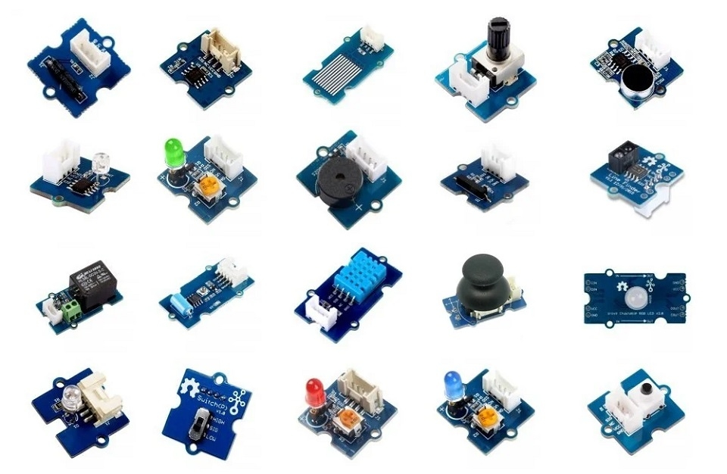
Sensor Classification

Slide 5
Sensor Classification
1. By Operating Principle:
Contact Sensors
Non-contact Sensors
2. By Measured Quantity:
Temperature Sensors
Pressure Sensors
Position/Displacement Sensors
Optical Sensors
Chemical Sensors
3. By Output Signal:
Analog Sensors
Digital Sensors

Slide 6
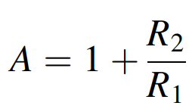
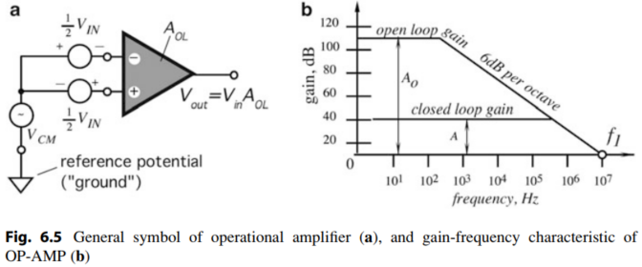
Signal Conditioners
Operational Amplifiers (Op-Amp)
OP-AMPs are also used as cells in custom-made integrated circuits—analog or mixed technology
Fig. 6.5a shows a good operational amplifier has the following properties (symbol representation of Op-Amp)
For moderate accuracy, the open-loop gain of an Op-Amp should be at least 100 times greater than closed-loop
For higher accuracy, ratio of open- and close-loop gains should be 1000 and more

Slide 7
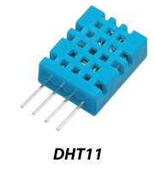
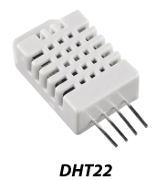
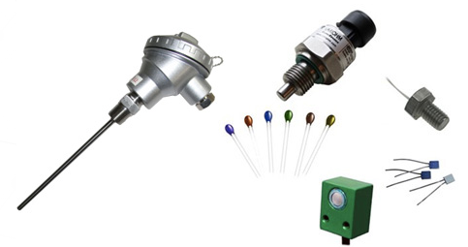
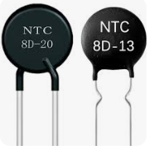
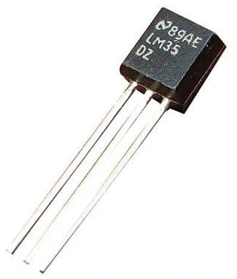
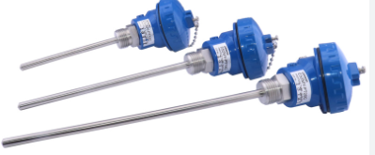
Temperature sensors

Slide 8
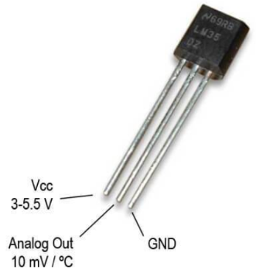
Temperature sensors – IC LM35
ADC 10bit: Vin = (Vref*ADC)/1024
ADC 8bit: Vin = (Vref*ADC)/256

Slide 9
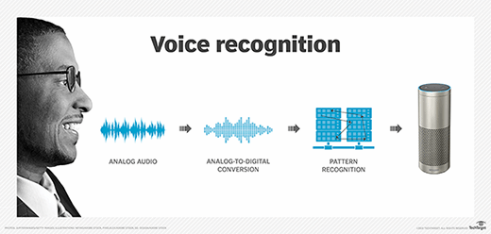
Sound sensors

Slide 10
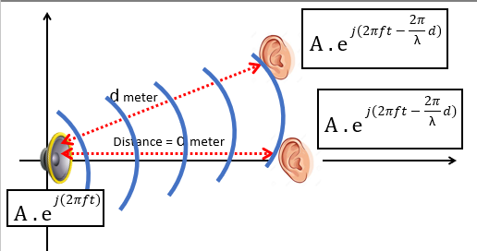
Sound sensors

Slide 11
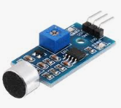
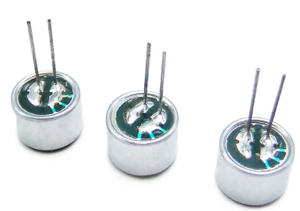
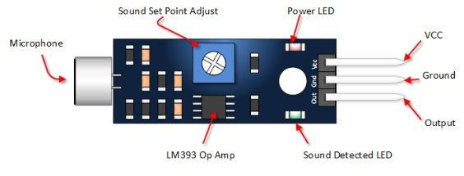
Sound sensors

Slide 12
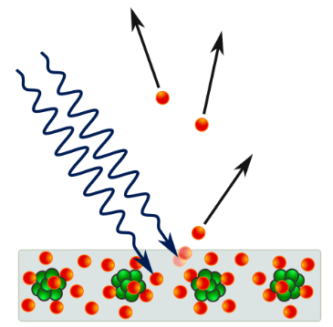
Light sensors

Slide 13
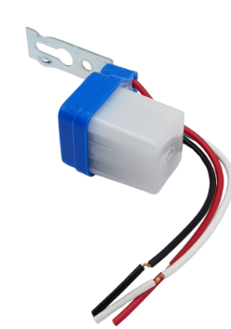
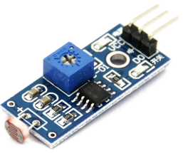
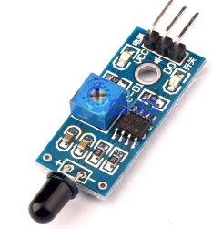
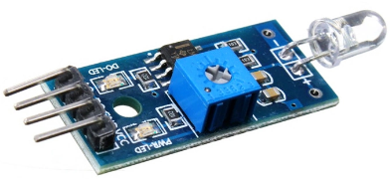
Light sensors

Slide 14
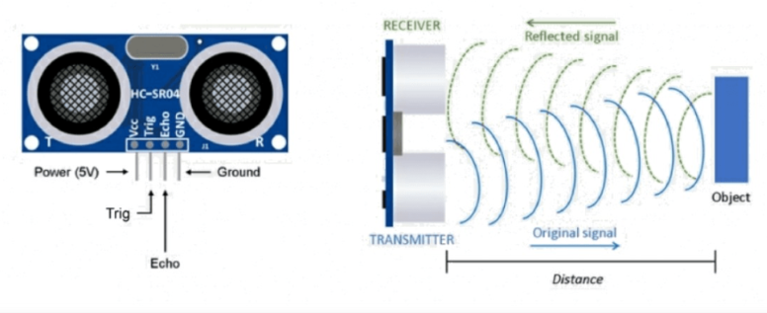
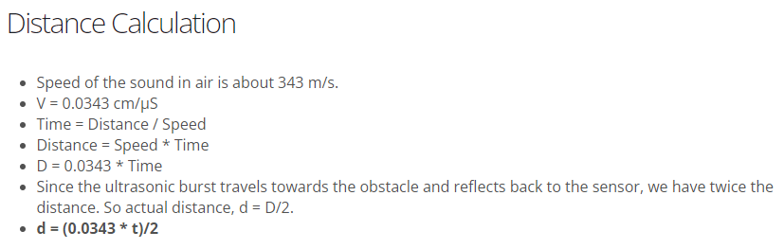
Ultranic Distance sensors

Slide 15
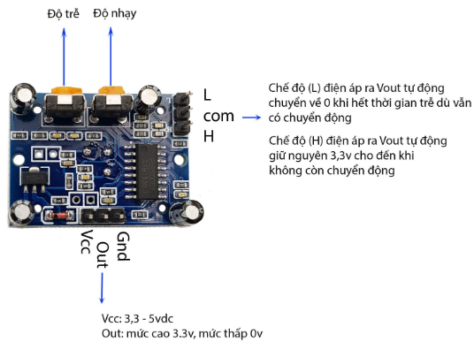
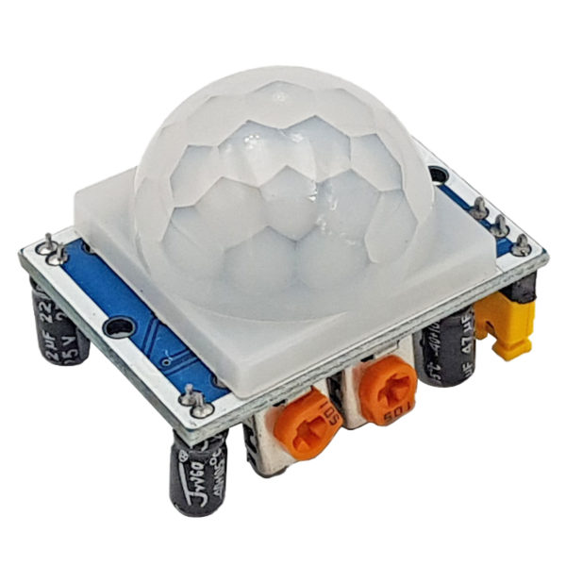
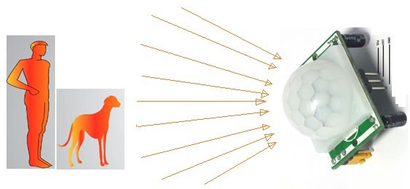
PIR sensors

Slide 16
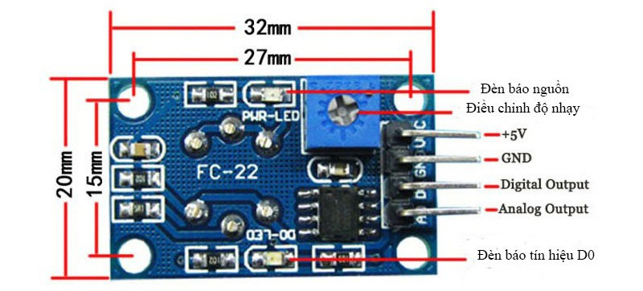
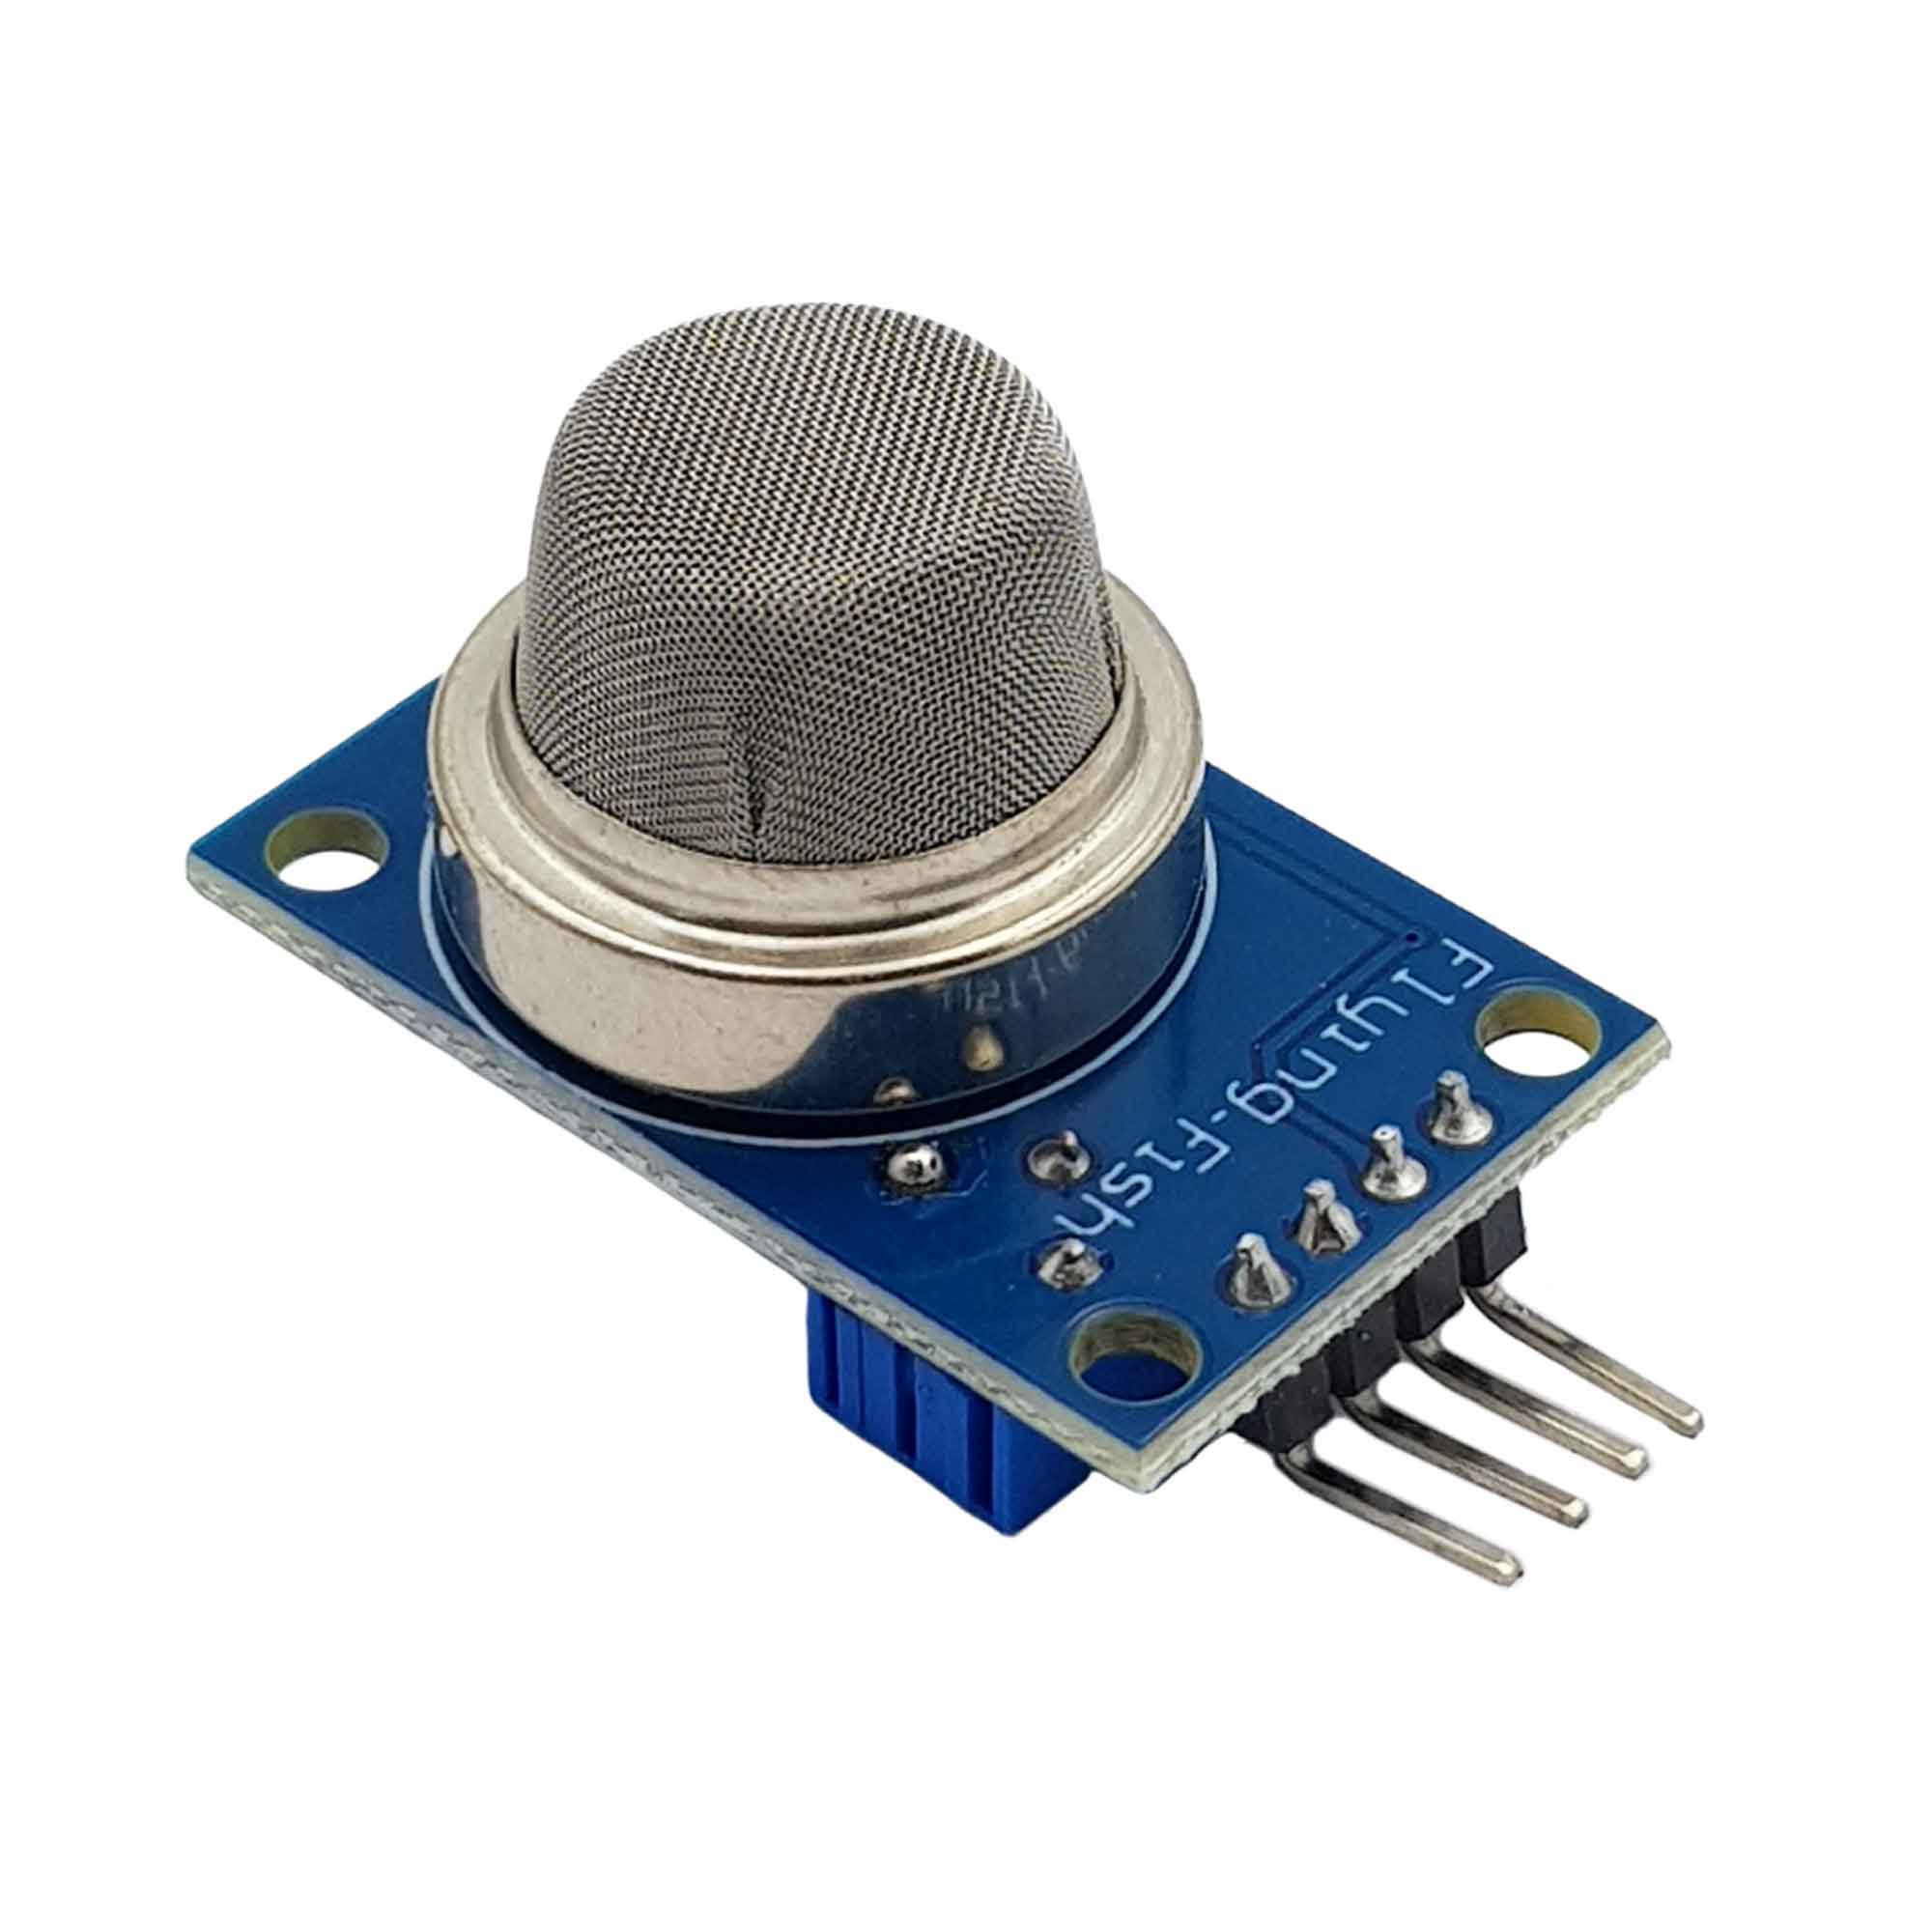
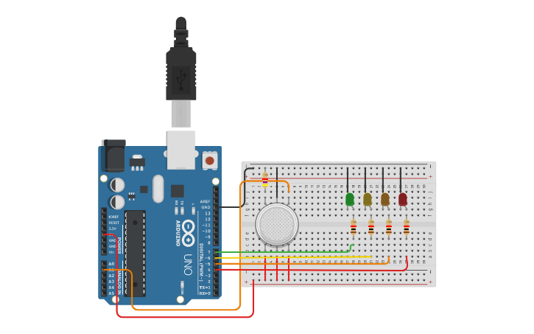
GAS sensors

Slide 17
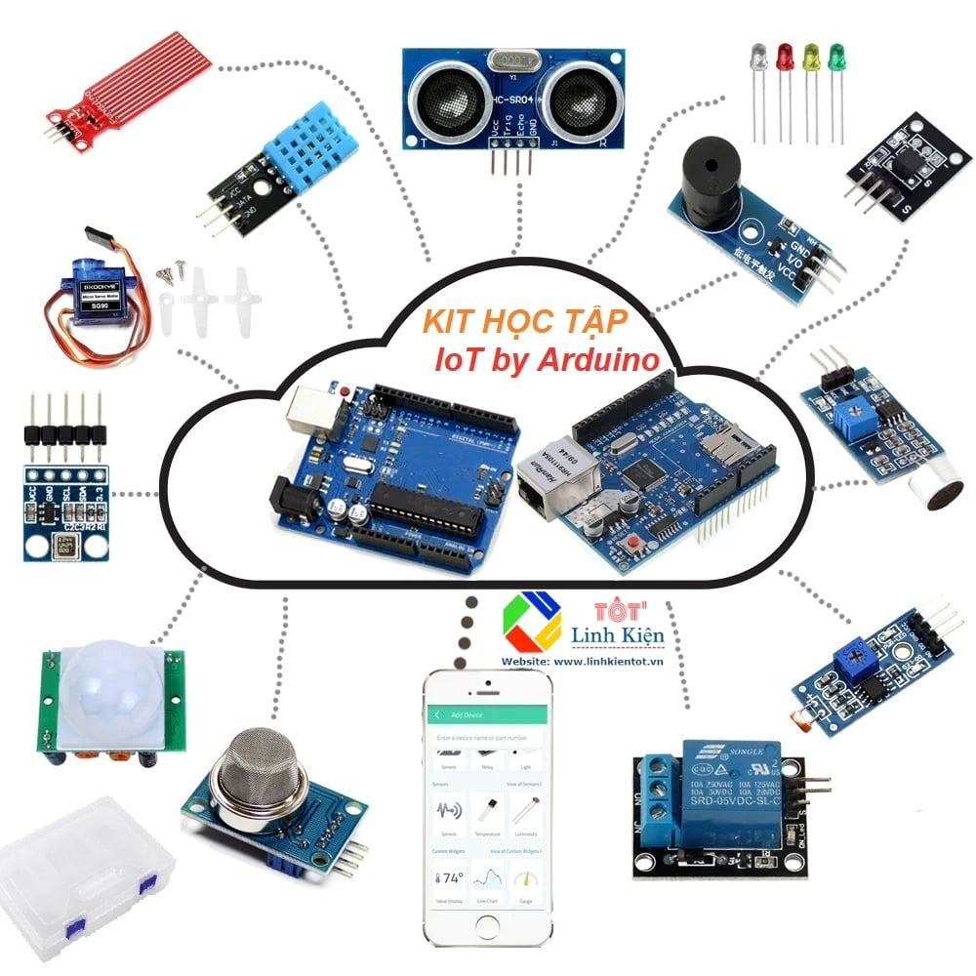
THANK YOU

